Slide 1
Relational Models

Slide 2
JOIN Operations
Natural join
Theta join
Outer joins
Left outer join
Right outer join
Full outer join

Slide 3
Natural Join
JOIN clause is used to combine rows from two or more tables, based on a common field between them.
The natural join is denoted as R S.
Where R and S are two different relations.

Slide 4
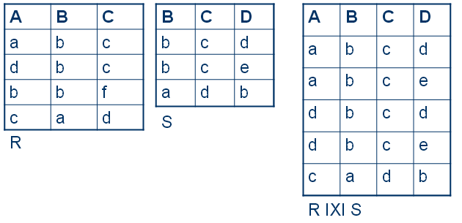
Example

Slide 5

Left Outer Join
The LEFT JOIN keyword returns all rows from the left table (table1), with the matching rows in the right table (table2).
The result is NULL in the right side when there is no match.
In some databases LEFT JOIN is called LEFT OUTER JOIN.
Denoted using

Slide 6
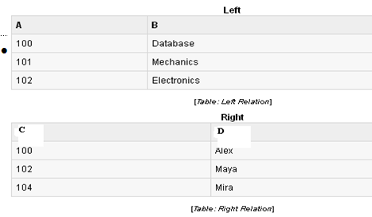
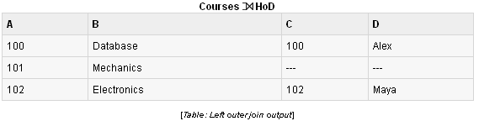
Example

Slide 7

Right Outer Join
The RIGHT JOIN keyword returns all rows from the right table (table2), with the matching rows in the left table (table1).
The result is NULL in the left side when there is no match.
In some databases RIGHT JOIN is called RIGHT OUTER JOIN.
Denoted using

Slide 8
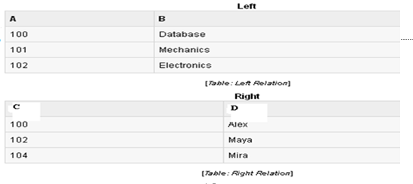
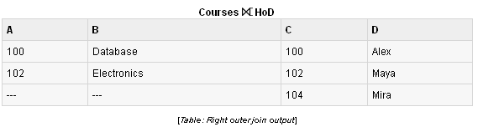
Example

Slide 9

Full Outer Join
The FULL OUTER JOIN keyword returns all rows from the left table (table1) and from the right table (table2).
The FULL OUTER JOIN keyword combines the result of both LEFT and RIGHT joins.
Denoted using

Slide 10
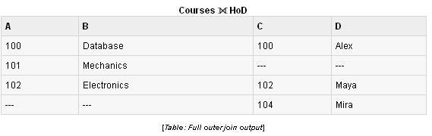
Example

Slide 11
Theta Join(θ-Join)
R _{F}S
Defines a relation that contains tuples satisfying the predicate F from the Cartesian product of R and S.
Can rewrite Theta join using basic Selection and Cartesian product operations.
R _{F}S = σ_{F}(R Χ S)

Slide 12

Contd..
The join condition can be
When the join condition operator is ‘= ‘,then we call this an Equijoin.
Note :The attributes in common are repeated in equi-join whereas the redundancy is eliminated in natural join.

Slide 13
Example
STUDENT | Regno | Name | Age | Phone
2 records | BIT001 | Ram | 15 | 8652398452
 | BIT023 | Selvi | 17 | 7894562310
SUB_REGD | SRegno | Subject
3 records | BIT001 | Physics
 | BIT023 | Computer
 | BIT023 | OS

Slide 14
Join Operation
STUDENT X SUB_REGD | Regno | Name | Age | Phone | SRegno | Subject
2 X 3 = 6 records | BIT001 | Ram | 15 | 8652398452 | BIT001 | Physics
 | BIT001 | Ram | 15 | 8652398452 | BIT023 | Computer
 | BIT001 | Ram | 15 | 8652398452 | BIT023 | OS
 | BIT023 | Selvi | 17 | 7894562310 | BIT001 | Physics
 | BIT023 | Selvi | 17 | 7894562310 | BIT023 | Computer
 | BIT023 | Selvi | 17 | 7894562310 | BIT023 | OS

Slide 15
List studetails FROM student, sub_regd WHERE regno = sregno;
RA: σ_{regno = sregno} (student X sub_regd)
σ_{regno = sregno} (student X sub_regd)
Regno | Name | Age | Phone | SRegno | Subject
BIT001 | Ram | 15 | 8652398452 | BIT001 | Physics
BIT023 | Selvi | 17 | 7894562310 | BIT023 | Computer
BIT023 | Selvi | 17 | 7894562310 | BIT023 | OS

Slide 16
List regno, name, phone FROM student, sub_regd WHERE regno = sregno;

Slide 17
RA: σ_{regno = sregno}(Π _{regno, name, phone} (student) X sub_regd)
σ_{regno = sregno} (Π _{regno, name, phone} (student) X sub_regd)
Regno | Name | Phone | SRegnoubject | Subject
BIT001 | Ram | 8652398452 | BIT001 | Physics
BIT023 | Selvi | 7894562310 | BIT023 | Computer
BIT023 | Selvi | 7894562310 | BIT023 | OS

Slide 18
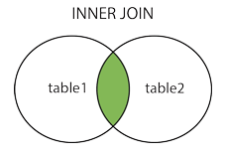
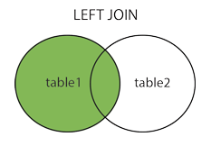
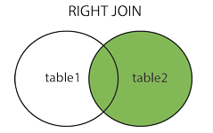
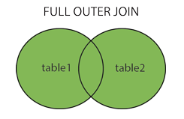

Slide 19
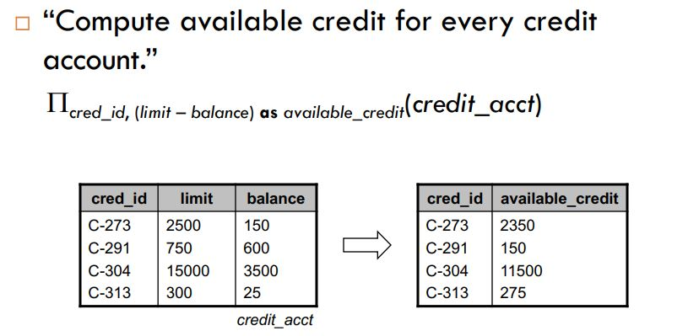
Generalized Projection

Slide 20
Aggregate Functions
Very useful to apply a function to a collection of
values to generate a single result
Most common aggregate functions:
sum sums the values in the collection
avg computes average of values in the collection
count counts number of elements in the collection
min returns minimum value in the collection
max returns maximum value in the collection

Slide 21

Aggregate Functions
Aggregate functions perform a calculation on a set of values and return a single value.
Denoted using the symbol ‘ .’(calligraphic G)
Examples:
SUM
MINIMUM (MIN)
MAXIMUM (MAX)
AVERAGE (AVG)
COUNT

Slide 22
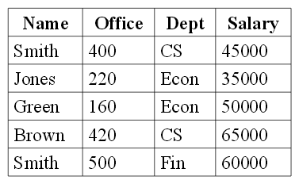

Example
Assume the relation EMP has the following tuples:
Find the minimum Salary: _{MIN (salary)(}EMP):

Slide 23
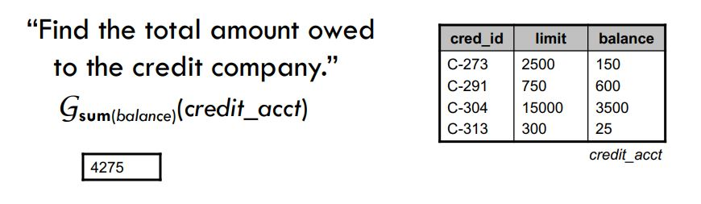

Slide 24
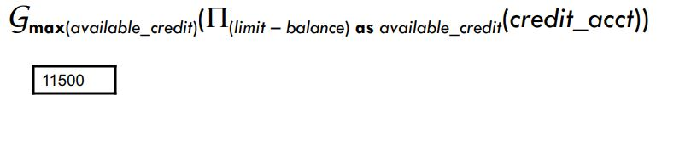
“Find the maximum available credit of any account.”

Slide 25
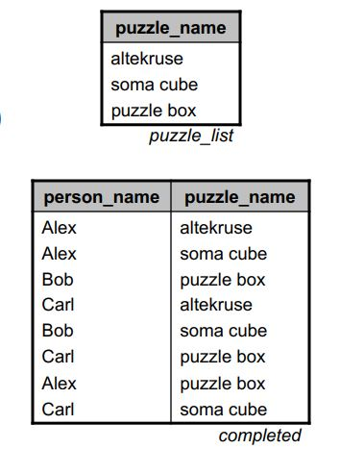
puzzle database:
puzzle_list(puzzle_name)
completed(person_name, puzzle_name)

Slide 26
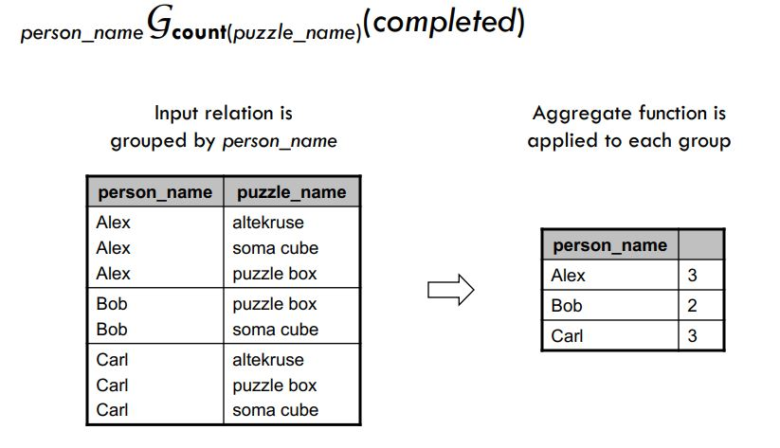
How many puzzles has each person completed?

Slide 27
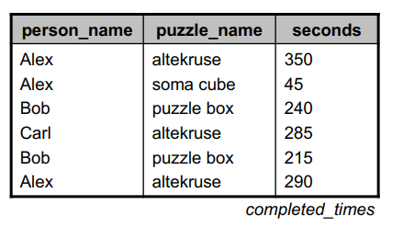

“How many puzzles has each person completed?”

Slide 28
